Slide 1
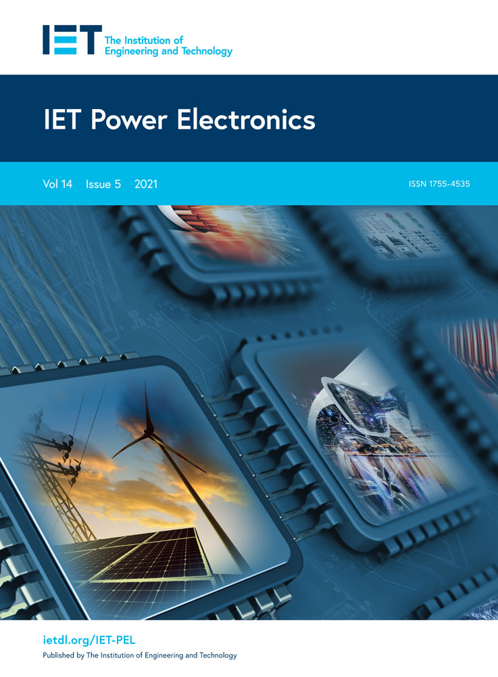
Weixin IDWileyEngineer
Weixin IDWileyEngineer
CiteScore 6.0
Impact Factor
2.0
Editor-in-Chief: Volker Pickert (Newcastle University)
Covers applications and technologies in the field of power electronics with special focus on cost effective and efficient solutions, power dense and light systems, environmental and manufacturing friendly components, smart and robust technologies.
Open Access – articles are published under Creative Commons license and authors retain their own copyright.
Follow the journal on WileyEngineer WeChat, and Twitter @WileyEngineer and @IET_Journals.
http://wileyonlinelibrary.com/iet-pel

Slide 2
Publish Open Access in IET Power Electronics
Impact Factor 2.0
CiteScore 6.0
High downloads and readership meaning increased visibility for your research
Meet open access mandates
Authors retain copyright
Promotes outstanding research through best paper awards
Quick decision process supported by a strong editorial board
Various geographic APC waivers/discounts available

